Slide 1

INSTITUTE :UIE
DEPARTMENT: ALL ACADEMIC UNITS
Bachelor of Engineering (All Sections)
Subject Name and Code:
Engineering Physics 23SPH-141
Prepared by: Anu Kapoor, Assistant Prof. Physics
LASER
DISCOVER . LEARN . EMPOWER

Slide 2
COURSE OBJECTIVES
The course is designed to make the students industry ready to contribute in the growing demand of the industry at local, national and international level.
It will make the students competent to understand basic concepts and applications of advanced engineering physics and apply its principles in their respective fields at global platform.
It will enhance the skill level of the students and shall make them preferred choice for getting employment in industry and research labs.
It will give thorough knowledge of the discipline to enable students to disseminate knowledge in pursuing excellence in academic areas.

Slide 3
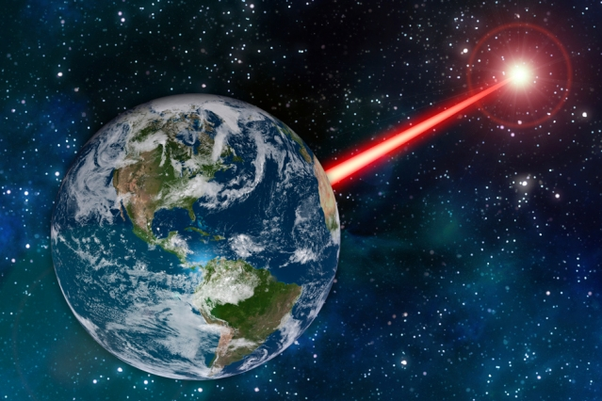
COURSE OUTCOMES
CO Number | Title On completion of this course, the students are expected to learn | Level
CO1 | Quote the basic fundamental concepts of lasers, optical fibres, crystallography, ultrasonic oscillations, semiconductor physics, quantum mechanics and nanotechnology. | Remember, Understand
CO2 | Demonstrate the working of various lasers, fibre components, semiconductor devices; explain the behaviour of crystalline solids, quantum and nano-scale systems. | Understand
CO3 | Solve problems by applying principles related to lasers, fibres, semiconductors, oscillations, quantum and nanoscience. | Applying
CO4 | Compare various lasers and fibres, semiconducting devices, crystalline materials, structures at quantum and nanoscale on the basis of their properties for industrial applications. | Analyze
CO5 | Develop various systems using lasers, fibres, semiconductors and nanomaterials for futuristic applications. | Design
Fig. 1 Introduction [1]

Slide 4

“ In the War of Worlds, written before the turn of 20th century, HG Wells told a fanciful story of how Martians invaded and almost conquered the earth. Their weapon was a mysterious sword of heat, from which flickered a ghost of a beam of light. It felled men in their tracks, made lead run like water and flashed anything combustible into masses of flame. Today Well’s word of heat comes close to reality in the laser…………”
Fig. 2 Introduction [2]

Slide 5

WHY TO STUDY LASER
Offering a high-speed way to process various materials, lasers are being used on a large scale in various industries.
Innovative technologies are driving the growth of industrial lasers. Manufacturers are introducing technologically advanced industrial lasers for various applications.
The global industrial laser market is highly dynamic, and growing at a fast pace.
The increasing innovations taking place in fiber lasers play an important role in the growth of the global industrial laser market
https://www.youtube.com/watch?v=_yLfLDHBUak [3]

Slide 6

CONTENT TO BE DISCUSSED….
He-Ne Laser
Construction
Working
Applications
Fig. 3 Introduction [4]

Slide 7
He-Ne LASER
First gas laser developed by Ali Javan and his coworkers in 1961.
Principle Features:
It is a gas laser
It uses four level pumping scheme
It uses electric discharge pumping technique
Output wavelength 632.8 nm
Continuous wave laser

Slide 8
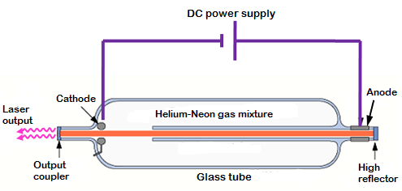
CONSTRUCTION
He-Ne Laser: An atomic laser consisting of
Active Medium; a mixture of 10 parts of He to 1 parts of Ne where Ne-atoms are active centers have energy levels suitable for laser transitions
He-atoms help efficient excitation of Ne-atoms
Figure 4 He-Ne Laser [7]

Slide 9
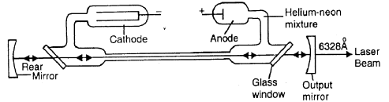
CONSTRUCTION
Discharge tube of about 30cm long, 1.5 cm in diameter, filled with a mixture of He & Ne gases in 10:1 ratio.
Electrodes connected to HV (10kV) to produce discharge in gas.
Glass mirrors at the end of discharge tube acting as mirrors of optical cavity resonator
Glass windows at Brewster’s angle to obtain polarized light

Slide 10
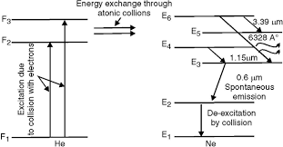
WORKING OF He-Ne LASER
HV of 10kV applied across the gas- ionizes the gas
Electrons & ions accelerated towards anode and cathode
Electrons being smaller in mass acquire higher velocity
Electrons transfer K.E. to He atoms through inelastic collisions
He atoms excited to levels F2 & F3 metastable levels
Figure 5 He-Ne Laser [8]

Slide 11
WORKING OF He-Ne LASER
He transfer energy to Ne-atom through collisions -Resonant transfer of energy. Possible in He-Ne atoms
Ne-atoms being heavy, could not be pumped up efficiently without He-atoms
Role of He-atoms is to excite Ne-atoms and cause P.I.
Probability to transfer energy from He-Ne is more ; 10 He per 1 Ne atoms.
Reverse probability i.e. Ne-He is extremely small
Figure 6 He-Ne Laser [8]

Slide 12
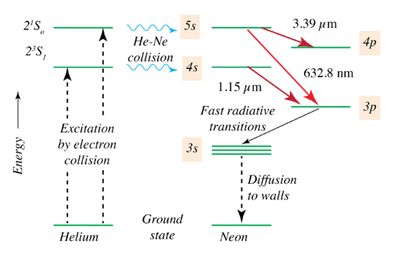
WORKING OF He-Ne LASER
E4 & E6 levels in Ne ; Metastable States Accumulation of atoms
Population inversion between E6 and E5, E3 levels & E4 and E3 levels
Lasing takes place and light is produced corresponding to
E6 E5
E6 E3
E4 E3
Ne-atoms in level E3 decays rapidly to E2
E2 to E1 transition induced by collisions with walls of discharge tube.
F3
E6
E5
E4
F2
E3
E2
F1
E1
Figure 7 He-Ne Laser [8]

Slide 13
He-Ne LASER OUTPUT
From E6 to E5 transitions; laser beam in IR region at 3390 nm
From E4 to E3 transitions; laser beam at wavelength of 1150 nm
From E6 to E3 transitions; laser beam of red color at 632.8 nm
In reality, several laser transitions, however, only three are dominant transitions.

Slide 14
He-Ne LASER APPLICATIONS
Major applications as Red light at 632.8 nm
Applications:
Laboratories,
Interferometry
Laser Printing
Bar Code Reader Scanners
Surveying
Alignment

Slide 15
SUMMARY
He-Ne Laser
Construction
working
Applications

Slide 16
FAQS
Why the ratio of He is more than that of Ne?
Why is discharge tube taken to be narrow?
Why reverse transfer of energy from Ne to He is not possible?
List advantages and disadvantages of Laser.

Slide 17
REFERENCES
[1] http://news.mit.edu/2018/laser-attract-alien-astronomers-study-1105
[2] https://www.gutenberg.org/files/36/36-h/36-h.htm
[3] https://www.youtube.com/watch?v=_yLfLDHBUak
[4] stockphoto.com/in/vector/abstract-red-laser-beam-transparent-isolated-on-black-background-vector-illustration-gm1048453908-280444377
[5] https://www.physics-and-radio-electronics.com/blog/absorption-of-radiation-spontaneous-emission-and-stimulated-emission/
[6] https://users.aber.ac.uk/ruw/teach/327/spec.php
[7] https://www.physics-and-radio-electronics.com/physics/laser/heliumneonlaser.html
[8] https://en.wikipedia.org/wiki/Helium%E2%80%93neon_laser
[9] Laud B.B., Laser and Non -Linear Optics, Edition 1st, (1991), Wiley Eastern Ltd.
[10] Beiser A, Concepts of Modern Physics,Edition 6th, (2003),Tata Mcgraw Hill, Noida.
[11] Bhattacharya D. K., Tandon Poonam, Engineering Physics.,Edition 1st , (2015), Oxford.
[12] Ghatak A. (2012) Optics, McGraw Hill Education. ISBN: 978-1259004346

Slide 18
THANK YOU
anukapoor.appsci@cumail.in

